Slide 1
Humidity and Temperature measurement with ARDUINO
From
Dr. G.V.Prasanna Anjaneyulu

Slide 2
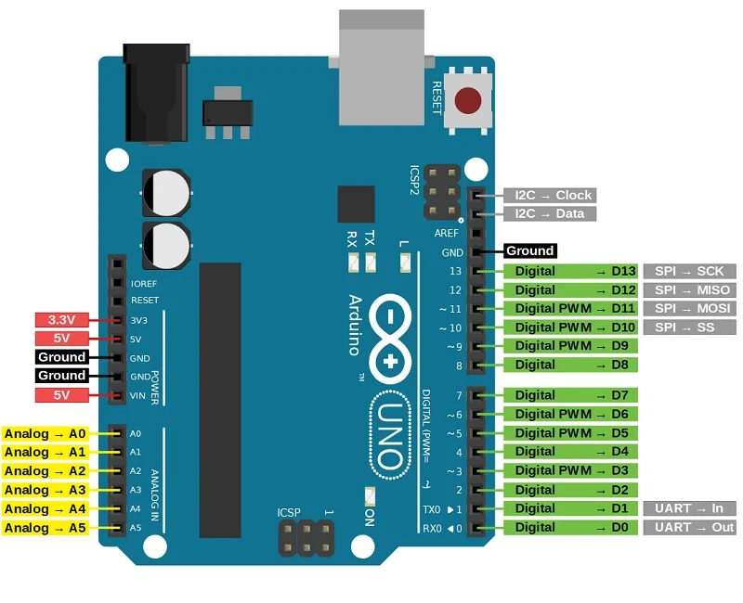
Dr. G. V. Prasanna Anjaneyulu
Humidity_Temperature Measurement by Dr.GVP

Slide 3
SENSOR - DHT11
Dr. G. V. Prasanna Anjaneyulu
Humidity_Temperature Measurement by Dr.GVP

Slide 4
DHT11 sensor
Here are the ranges and accuracy of the DHT11:
Humidity Range: 20-90% RH
Humidity Accuracy: ±5% RH
Temperature Range: 0-50 °C
Temperature Accuracy: ±2% °C
Operating Voltage: 3V to 5.5V
Dr. G. V. Prasanna Anjaneyulu
Humidity_Temperature Measurement by Dr.GVP

Slide 5
Types of DHT11 sensors
3-Terminal DHT Sensor
4-Terminal DHT Sensor
Dr. G. V. Prasanna Anjaneyulu
Humidity_Temperature Measurement by Dr.GVP

Slide 6
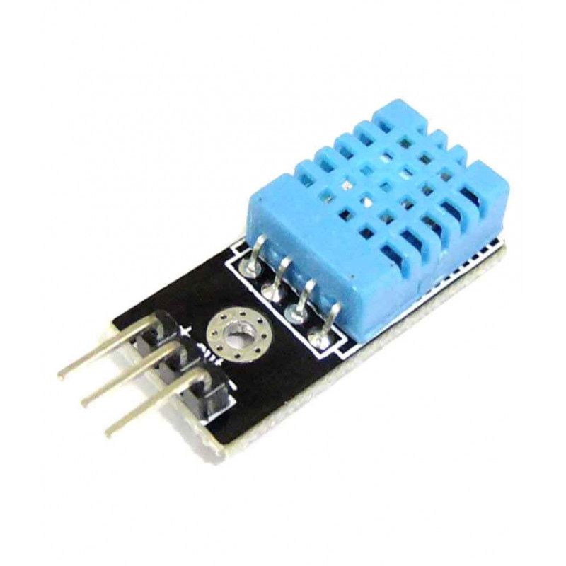
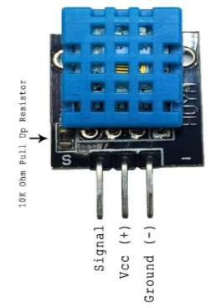
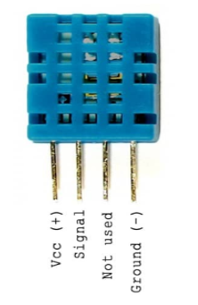
Images
Dr. G. V. Prasanna Anjaneyulu
Humidity_Temperature Measurement by Dr.GVP

Slide 7
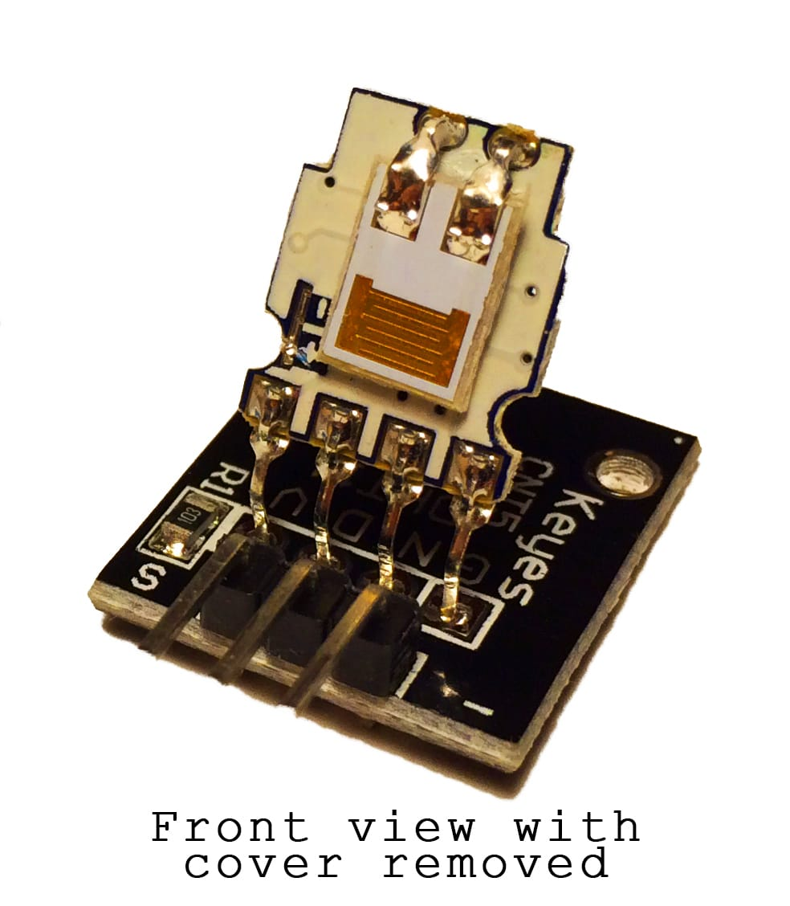
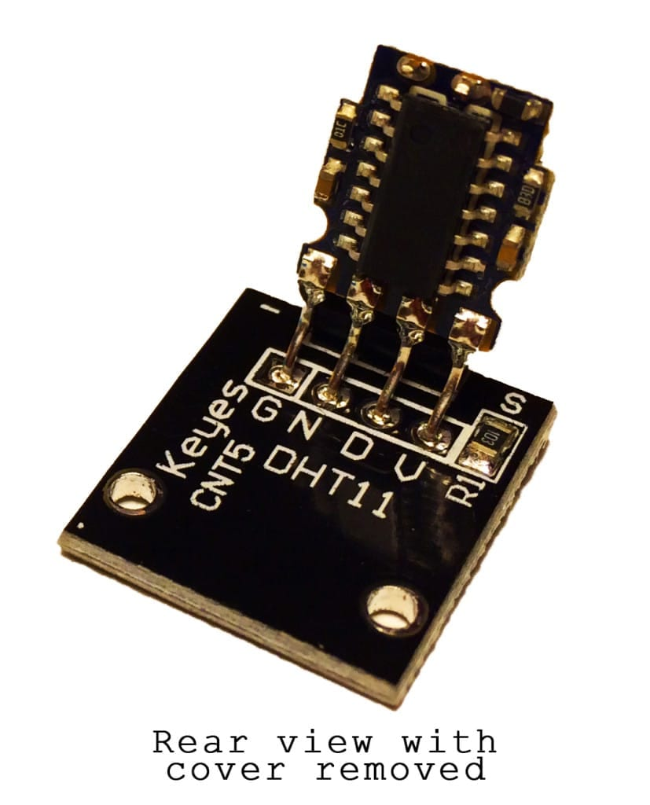
Inside views
Dr. G. V. Prasanna Anjaneyulu
Humidity_Temperature Measurement by Dr.GVP

Slide 8
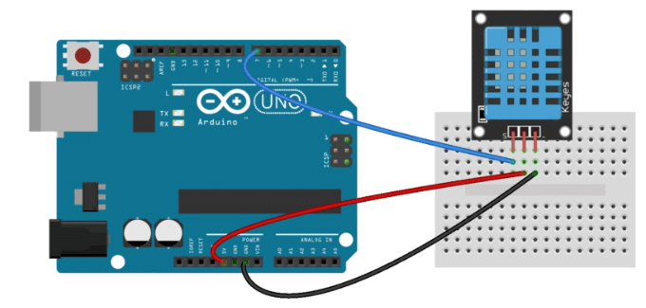
HOW TO SET UP THE DHT11 ON AN ARDUINO
CONNECTING A THREE PIN DHT11
Dr. G. V. Prasanna Anjaneyulu
Humidity_Temperature Measurement by Dr.GVP

Slide 9
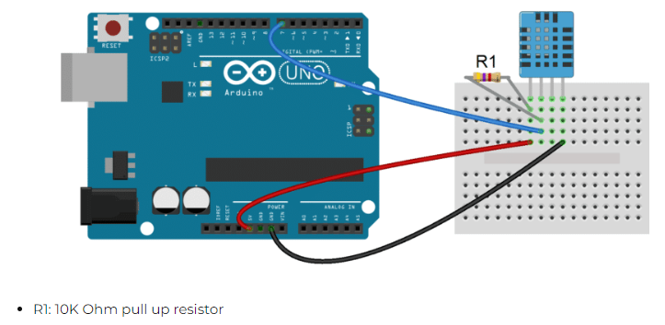
2. CONNECTING A FOUR PIN DHT11
Dr. G. V. Prasanna Anjaneyulu
Humidity_Temperature Measurement by Dr.GVP

Slide 10
Lab Experiment - Apparatus
1.PC with Arduino IDE
2.Arduino UNO Board
3.USB cable
4.Humidity and Temperature sensor [3pin - DHT11]
5.Bread board
6.Jumper wires
Dr. G. V. Prasanna Anjaneyulu
Humidity_Temperature Measurement by Dr.GVP

Slide 11
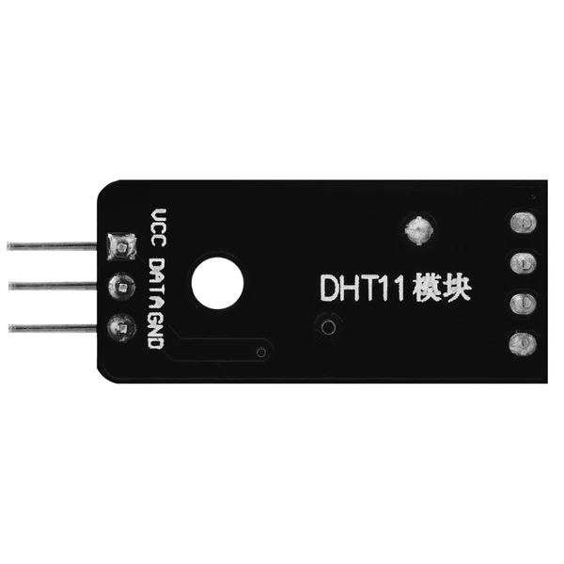
Lab sensor
Dr. G. V. Prasanna Anjaneyulu
Humidity_Temperature Measurement by Dr.GVP

Slide 12
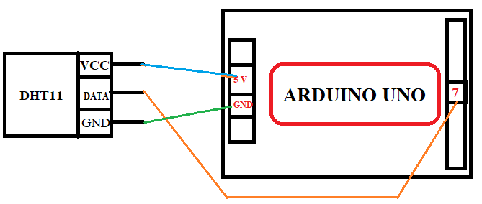
Circuit diagram
Dr. G. V. Prasanna Anjaneyulu
Humidity_Temperature Measurement by Dr.GVP

Slide 13
Case-1
DISPLAY HUMIDITY AND TEMPERATURE ON THE SERIAL MONITOR
Dr. G. V. Prasanna Anjaneyulu
Humidity_Temperature Measurement by Dr.GVP

Slide 14
Program
#include <dht.h>
dht DHT;
#define DHT11_PIN 7
void setup()
{
Serial.begin(9600);
}
void loop()
{
int chk = DHT.read11(DHT11_PIN);
Serial.print("Temperature = ");
Serial.println(DHT.temperature);
Serial.print("Humidity = ");
Serial.println(DHT.humidity);
delay(1000);
}
Dr. G. V. Prasanna Anjaneyulu
Humidity_Temperature Measurement by Dr.GVP

Slide 15
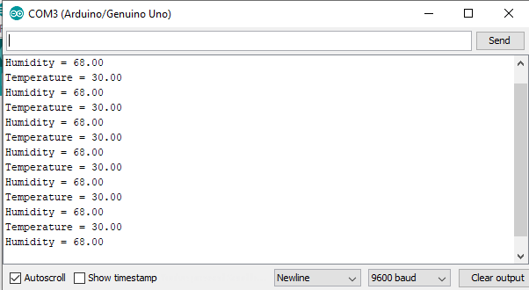
Output
Dr. G. V. Prasanna Anjaneyulu
Humidity_Temperature Measurement by Dr.GVP

Slide 16
Case-2
DISPLAY HUMIDITY AND TEMPERATURE ON AN LCD
Humidity_Temperature Measurement by Dr.GVP

Slide 17
Program
#include <dht.h>
#include <LiquidCrystal.h>
LiquidCrystal lcd(12, 11, 5, 4, 3, 2);
dht DHT;
#define DHT11_PIN 7
void setup()
{
lcd.begin(16, 2);
}
void loop()
{
int chk = DHT.read11(DHT11_PIN);
lcd.setCursor(0,0);
lcd.print("Temp: ");
lcd.print(DHT.temperature);
lcd.print((char)223);
lcd.print("C");
lcd.setCursor(0,1);
lcd.print("Humidity: ");
lcd.print(DHT.humidity);
lcd.print("%");
delay(1000);
}
Dr. G. V. Prasanna Anjaneyulu
Humidity_Temperature Measurement by Dr.GVP

Slide 18
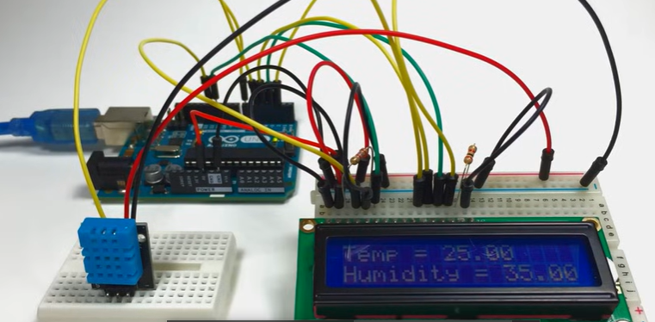
Implementation
Dr. G. V. Prasanna Anjaneyulu
Humidity_Temperature Measurement by Dr.GVP

Slide 19
DHT11 Zip file link
https://drive.google.com/file/d/1cEem9CWXDtPmrrDey4CmJNHj61qi3Piz/view?usp=drive_link
Dr. G. V. Prasanna Anjaneyulu

Slide 20
Thank you
Dr. G. V. Prasanna Anjaneyulu

